Slide 1

Saurabh Zulkanthiwar
City of Boston Earnings Analysis

Slide 2
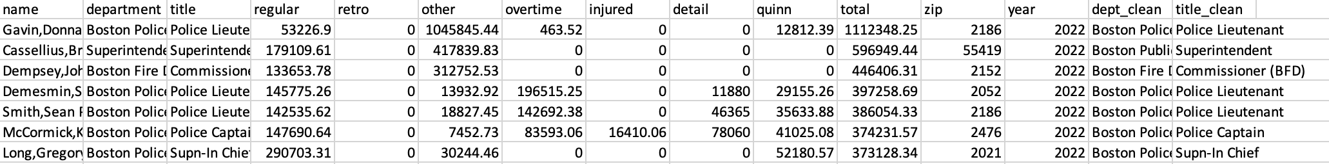
Introduction
2019: 23,000
2020: 21859
2021: 22547
2022: 23,205
Count of Employees per year
City of Boston publishes detailed earnings for city employees Every year
–
What top departments contribute to Boston?
Are employees who earn $150k or more likely to go for overtime?
Is there evidence of wealth segregation area-wise (income vs. area they live)?
How does the bill affect all earners, and is there any inclination over the years?
Which department makes the most money? It's like finding out who the rockstars of the job world are.
–
–
–
–
Earnings categories
Years 2019
through 2022
~ 22,000
employees per year
Data cleaning was needed for a few items:
●
–
Some departments consolidated and/or changed names Titles are spelled out in various ways
Some employees list work place zip code or wrong/missing zip code
–
–

Slide 3
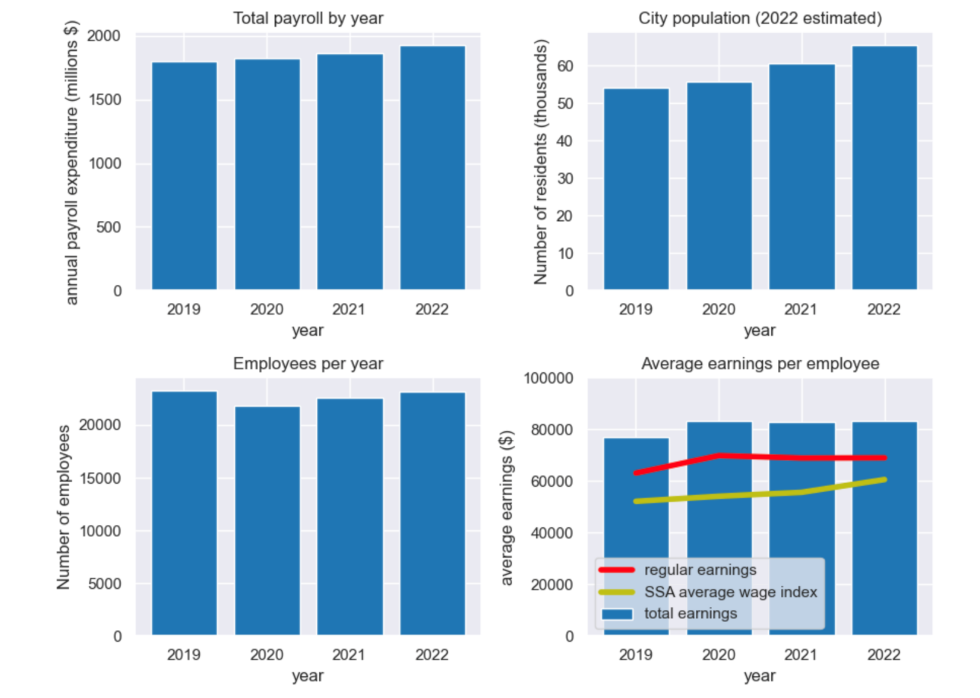
Payroll Change over years
Downloaded new Boston data: Population and Average Wage Index (AWI).
●
Biggest increase in total payroll between 2021 and 2022
The number of employees decreased during the pandemic period, but then gain the momentum
Significant growth in average earnings per employee
●
●
Slower growth than SSA average wage index in recent years
SSA has an DECLINED trend, on the country's avg. regular income INCLINED in Boston.

Slide 4
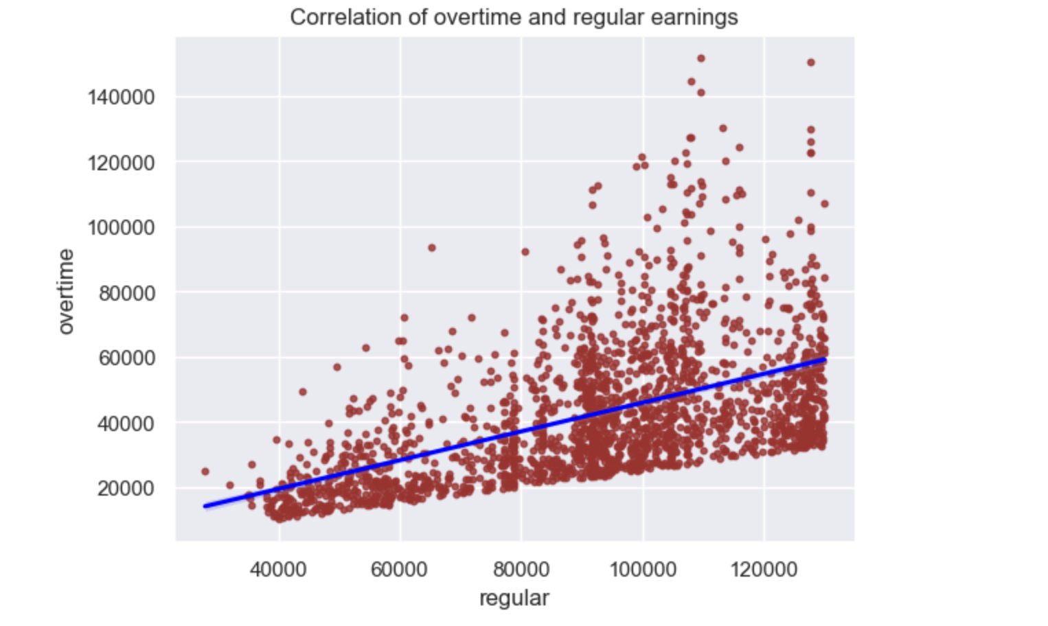
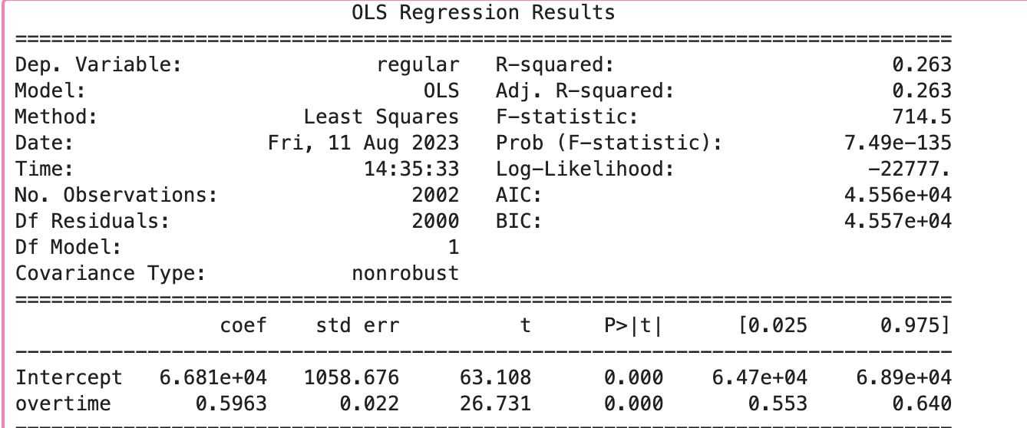
Overtime trends with regular income
Lower to mid-level income employees are the ones primarily engaging in overtime. Thus, we're setting a $120k overtime limit.
●
From the OLS regression, lower regular earnings correspond to about a 90-cent increase in injured pay per dollar.
●
each unit increase in overtime, regular earnings increase by approximately $0.60

Slide 5
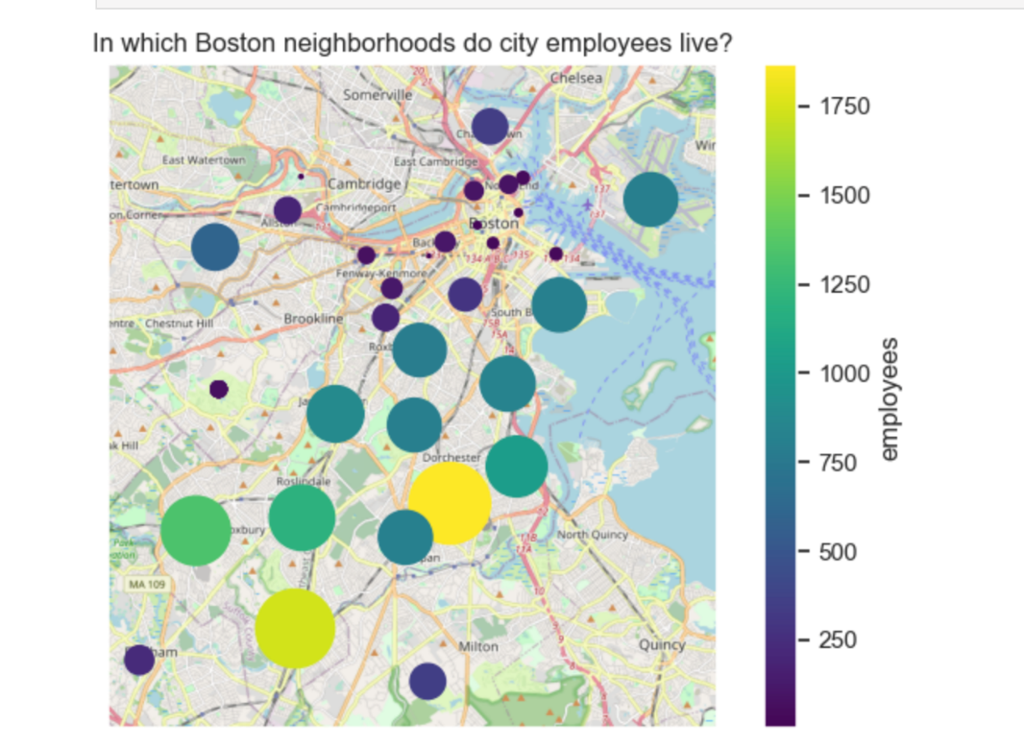
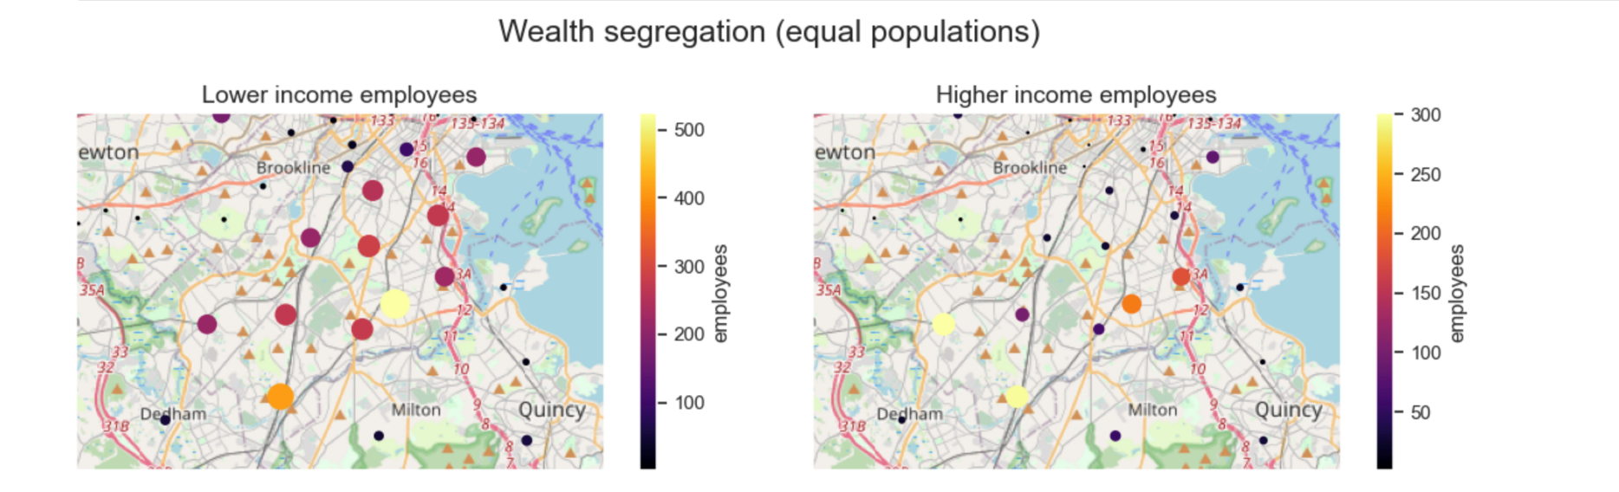
Wealth Segregation w.r.t income
●
The majority employer’s live in Roxbury, Dorchester & south Boston part
Higher income: Dedham , Quincy, Milton , Dorchester area.
●
Compare Housing PP area wise & segregate low vs high income
segregation
Rich – $150000k
Poor - $60k

Slide 6
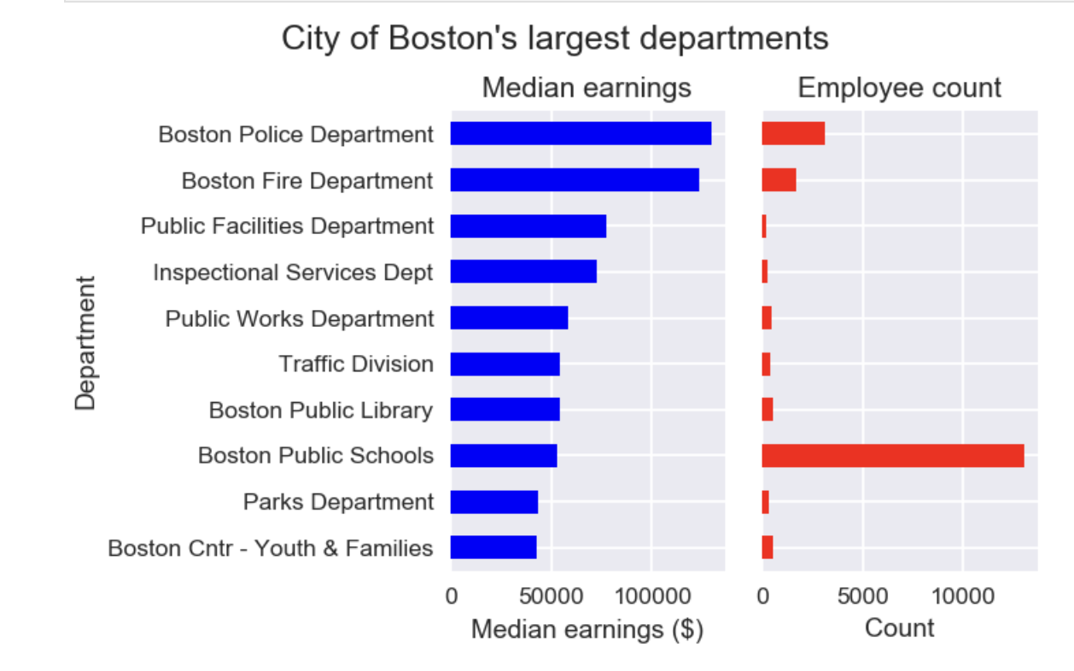
The top departments that contribute 70% to the Boston government.
●
Over 70% of employees are working in the 10 largest departments, therefore the remaining departments will not have a significant impact on the analysis

Slide 7
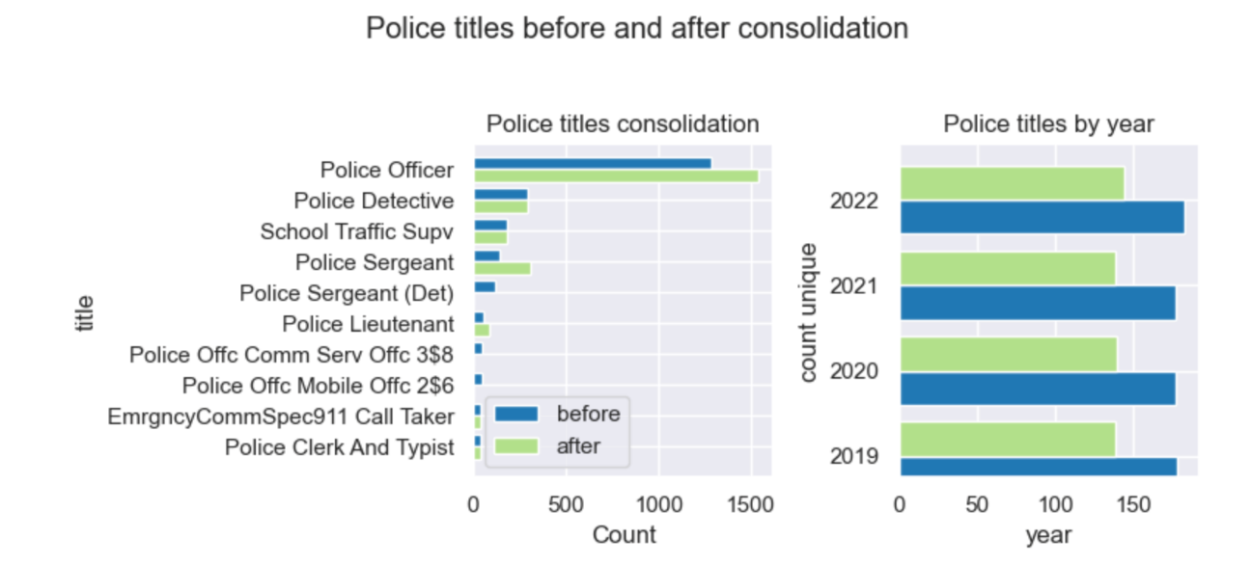
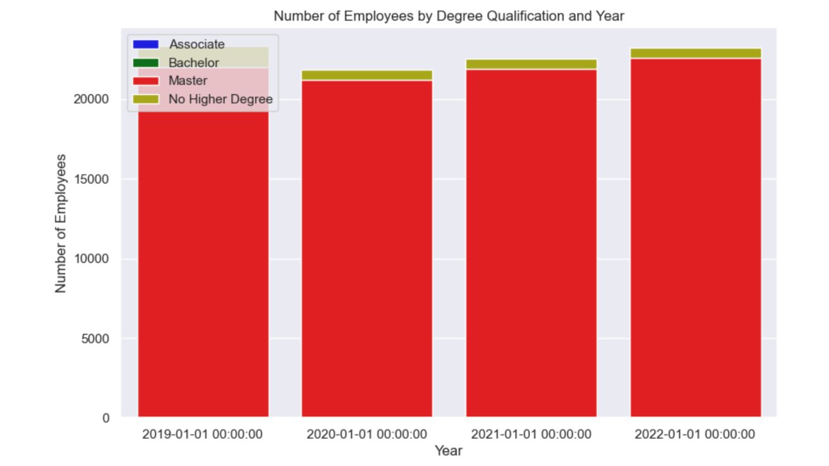
How is quin bill affecting all earners and is there any inclination through the years?
●
The Quinn Bill( 1970) more formally known as the Police Career Incentive Pay Program (PCIPP).
●
Increment in no. of titles by year wise
●
AS – 10 %
BS – 20%
MS – 25%
●

Slide 8
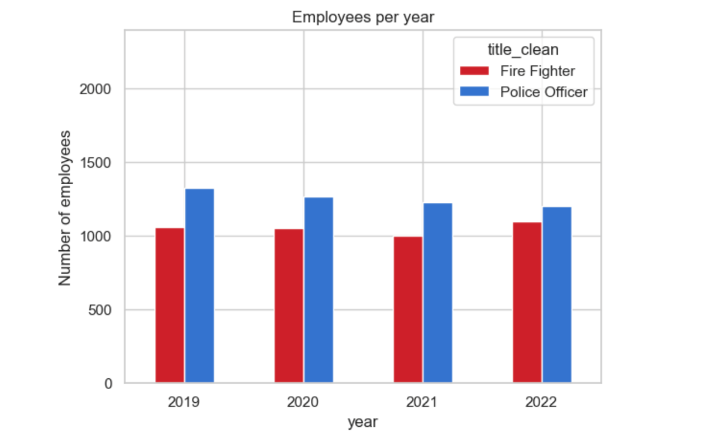
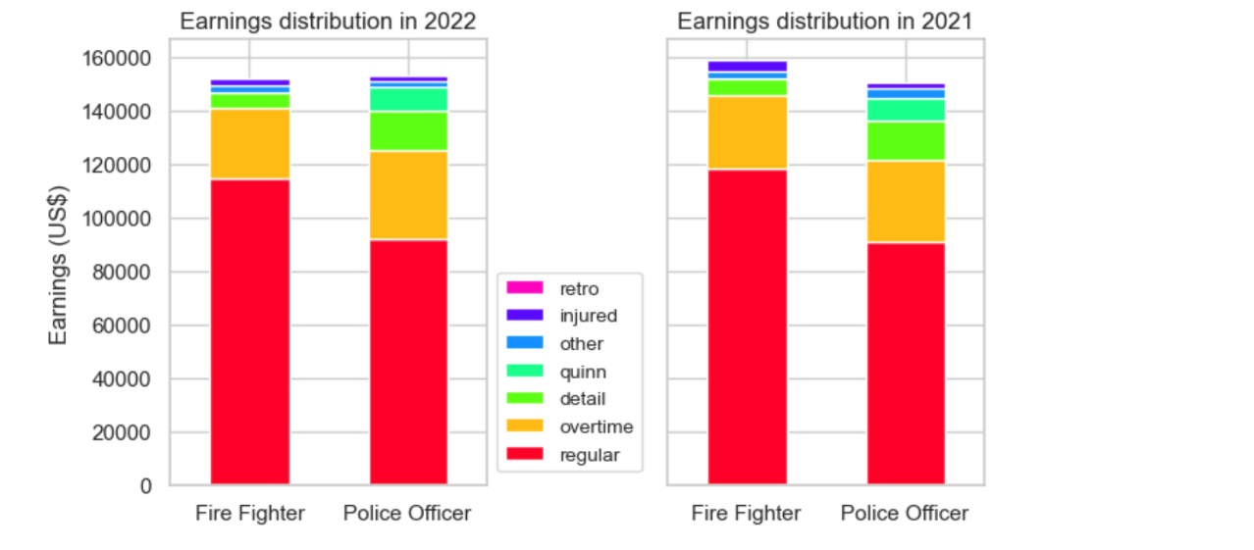
Police vs Fire Department
●
No. of Employee per year
Salary Distribution
In 2022 and 2021, there was a measurable difference in mean overtime pay between firefighters and police officers & no. of employers.
●
There are roughly 1000 FF and 1400 PO working for the city of Boston
We can see the no. of PO going down on the country FF going up
●
In 2022, firefighters have higher regular pay. In 2022, police officers saw a slight increase in all earnings categories.
●
●

Slide 9
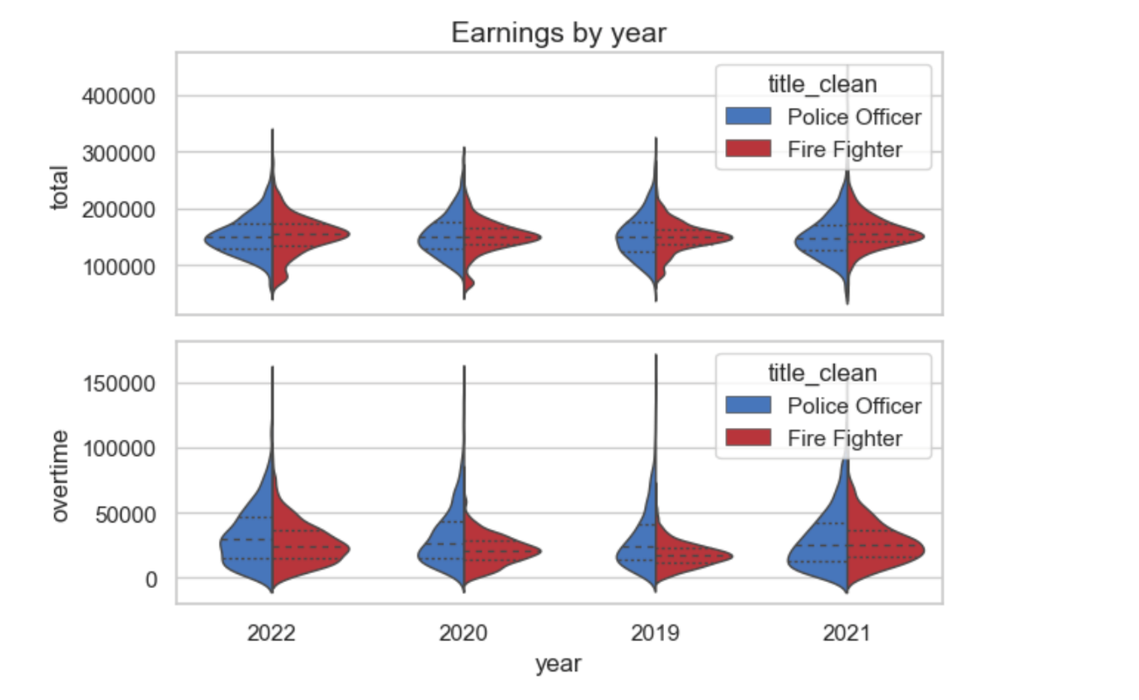
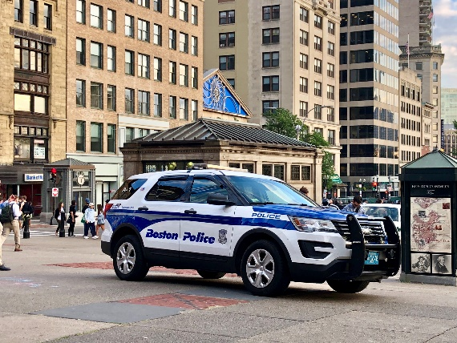
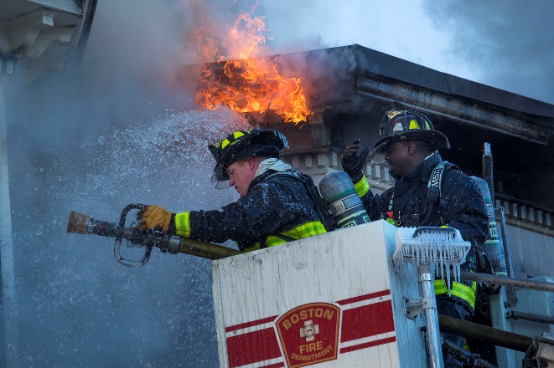
Police Officers and Firefighters(Salary distribution)
●
The median salary for PO & FF are around $100k to $150k
There’s no change during the pandemic time in FF but we can see there are changes in overtime salary in PO.
Po has the highest no. of officers but FF has the highest salary
●
●

Slide 10

Recommendations
●
Boston City should have to pay more money to FF for doing overtime.
Analyzing Quinn Bill’s education and overtime can offer insights for better human resource and workforce management at Boston Police Department.
On the basis of what they hire no. of employees in PO & FF department ( They have to mention)
We’ll get more information if we have the following data
●
●
●
●
–
Employment start date End date
Promotion date
Time to fill
Performance Metrics
Work Hours
Pay Increment
Age range
–
–
–
–
–
–
–
●
How many new employees are hired annually in Boston?

Slide 11
Conclusion
If any sudden situation happens Boston has enough PO & FF. using that no. Boston can prepare strategic plans.
an in-depth analysis of the relationship between education pursued under the Quinn Bill and overtime work can provide valuable insights that may lead to strategic improvements in the management of human resources and workforce planning within the Boston Police Department.
●
●

Slide 12
Thank you !

